Slide 1

Online Auction Database Management

Slide 2
Outline
Motivation
Introduction
Tools & Techniques
Simulation & Results
Conclusion
Future Work
Reference

Slide 3
Motivation
Auction is one of the ancient and popular market way. Online auction has ushered a new era ensuring a transparent and a win-win situation for all stakeholders i.e. the buyers enjoy all the benefits of bidding online and the seller enjoy all the benefits of listing a product online in front of millions of bidder.
Online auctions don’t have geographical boundaries.
Incredibly good deals can be found using online auctions. Time doesn’t have to be a problem because auctions can take place throughout the day and night.
Finally, transactions can be done quickly and reliably. If you’ve ever bought something at a local, in-person auction, you know it can be tedious waiting to finish up the transaction, whereas online works much faster.

Slide 4
Introduction
Our project is an online platform where a user will be able to post items online for auction. The items will accompany item name, selling price, and a picture presentation for the bidder to see The bidder, if interested in the item, will auction for the product.
The main goal was to provide easy way for buying and selling over the web.
Some of the advantages of online Auction are
Attracting the Buyers to Value
Devoid of Geographical Restrictions
Acceptance of Universal Products
Irresistible Deals All Around

Slide 5
Tools AND TECHNIQUES
The front end of this project has been designed using Java(Netbeans 8.0).
In the backend we’ve used MySql as the database and PHP as a server. The queries were written in MySql and then imported to PHP and hence linked to the front end of the application. MySql is a powerful database language that lets you store, organize and access data easily.
We used Xampp which helped us to create a local host/server as it offers MySQL(Database Server) and Apache(web browser) in one setup.

Slide 6
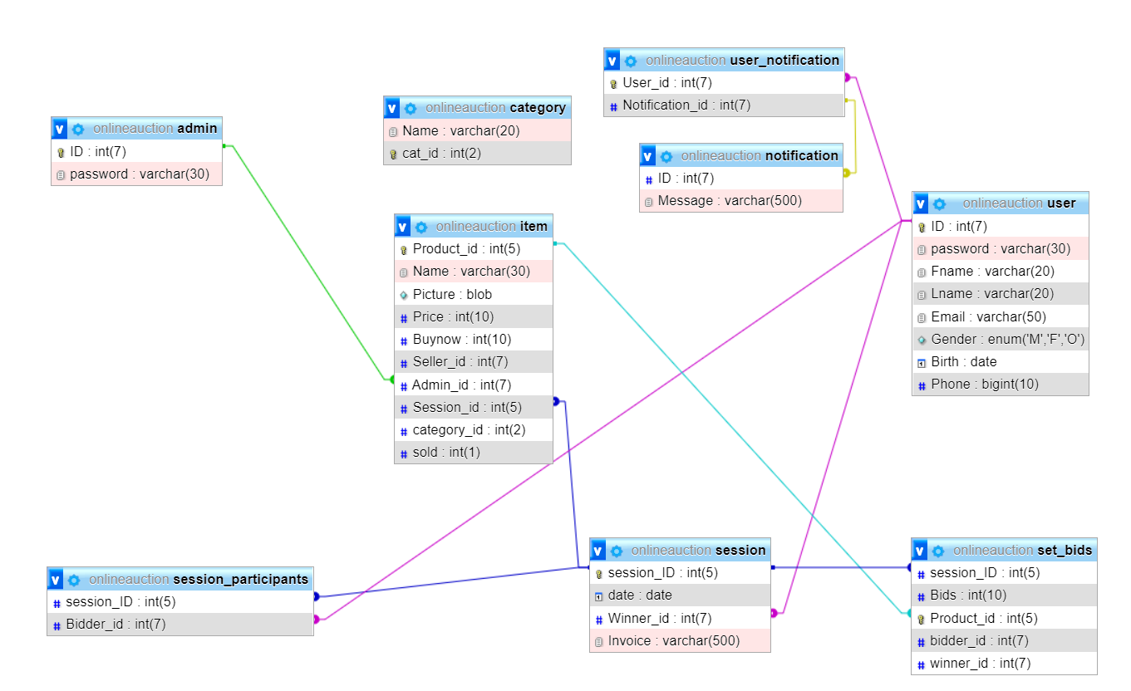
Relational Schema

Slide 7

Requirement Document
 | Implemented or Not
a. For User
User registration/Login | Yes
Profile Picture | No
Email format Verification | Yes
Password Verification | Yes
OTP verification of Email and Phone Number | No
View Profile | Yes
Edit Profile | Yes
Sell a product(With a Product Image) | Yes
Product/seller Verification | No
Buy a Product | Yes
Sort By Category | Yes
Sort By Price | No
Search a Product | No
Payment Option | No
Day Bound Session | Yes
Hours Bound sessions | No
User Notification | No
b. For Admin
Creating a Session | Yes
Approving a Product | Yes
Deleting a Product | Yes
Add new Categories | No
c. Overall System Security

Slide 8
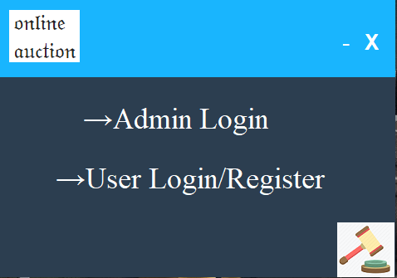
Simulation
Image 1:User/Admin Login

Slide 9
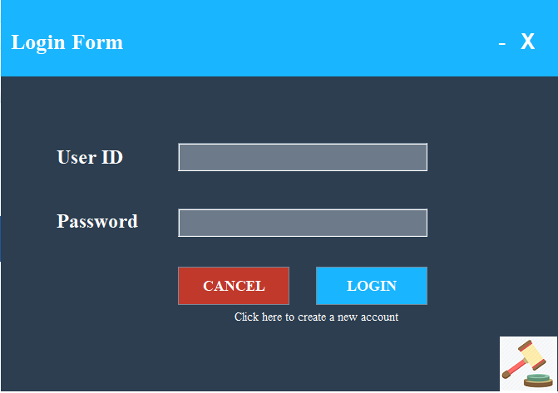
SimUlation
Image 2:User Login

Slide 10
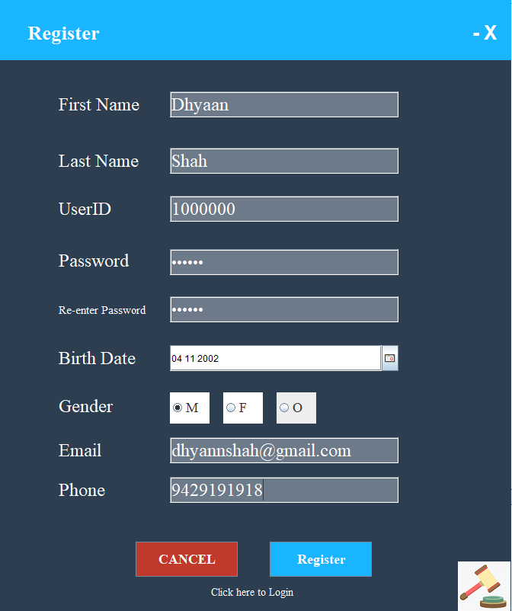
Simulation
Image 3:User Registration

Slide 11
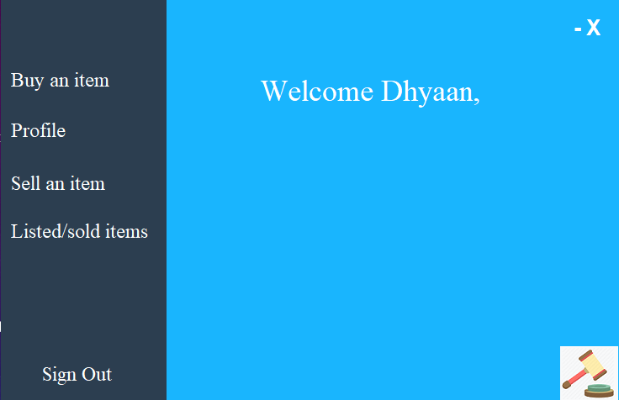
Simulation
Image 4:Home Page

Slide 12
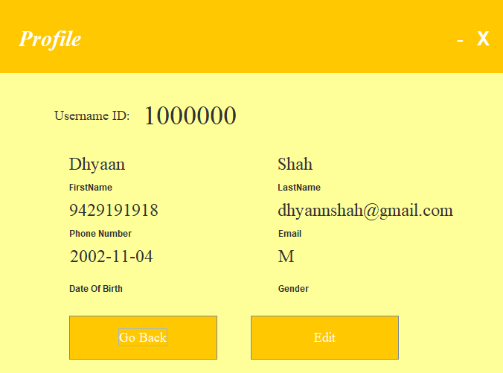
Simulation
Image 5:Profile

Slide 13
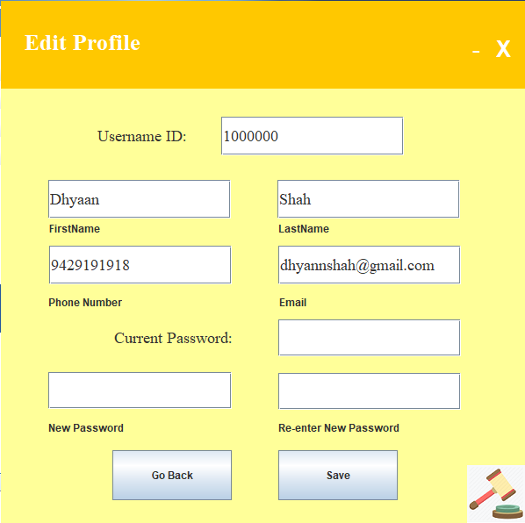
Simulation
Image 6:Edit Profile

Slide 14
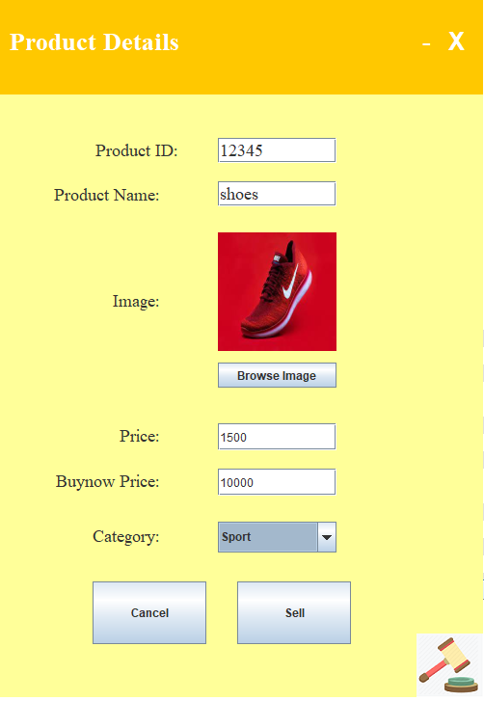
Simulation
Image 7:Selling an item

Slide 15
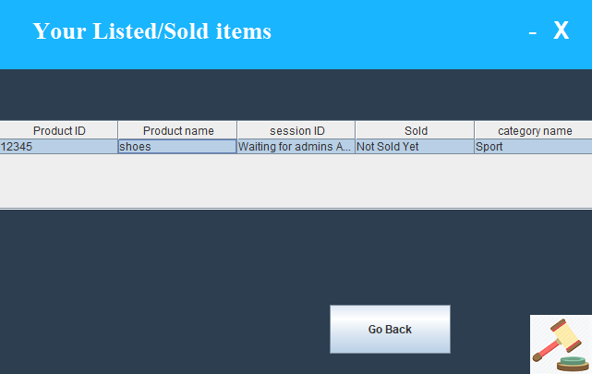
SimUlation
Image 8:View your Listed/Sold items

Slide 16
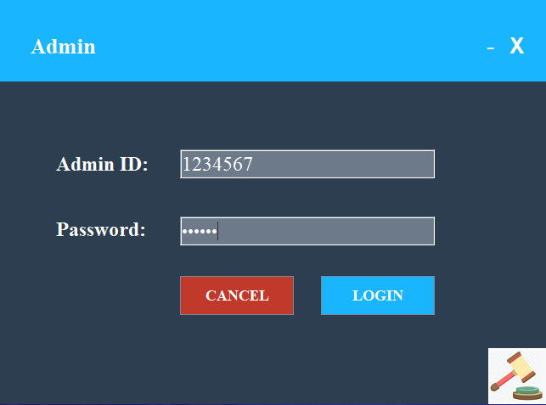
SimUlation
Image 9:Admin Login

Slide 17
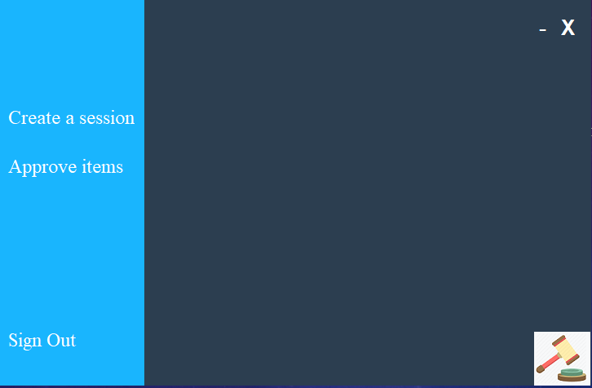
Simulation
Image 10:Admin Home Page

Slide 18
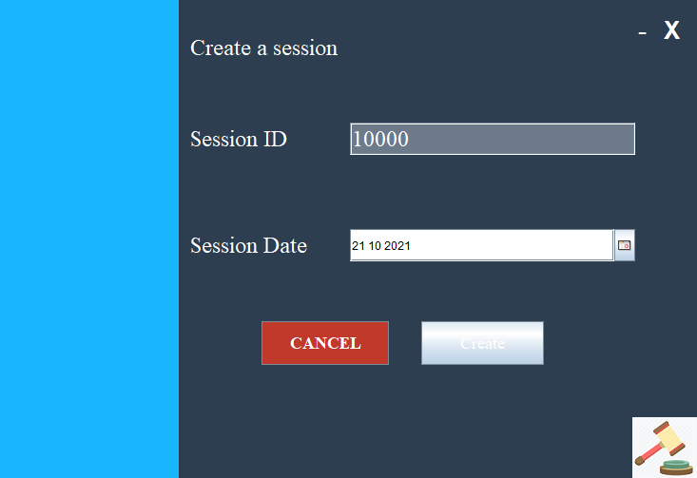
Simulation
Image 11:Session Creation Page

Slide 19
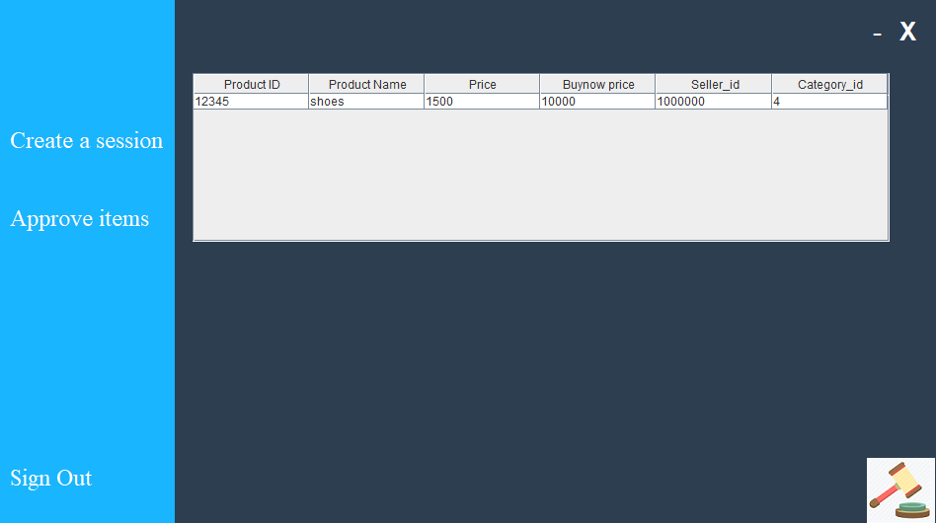
Simulation
Image 12:List of items to be Approved

Slide 20
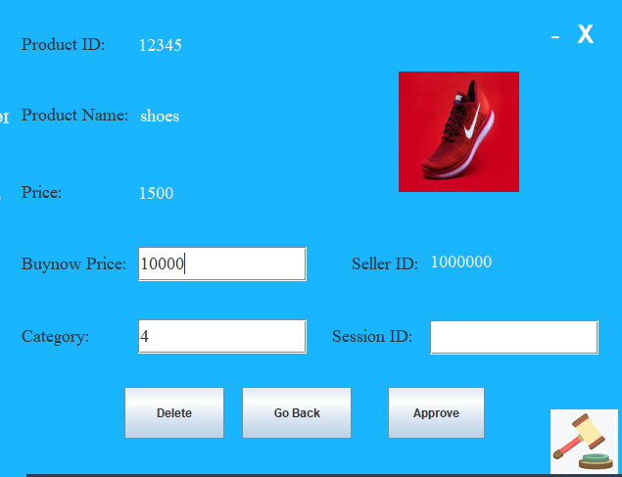
Simulation
Image 13:Admin Approving/deleting a particular item

Slide 21

Simulation
Image 14:Buy Menu

Slide 22
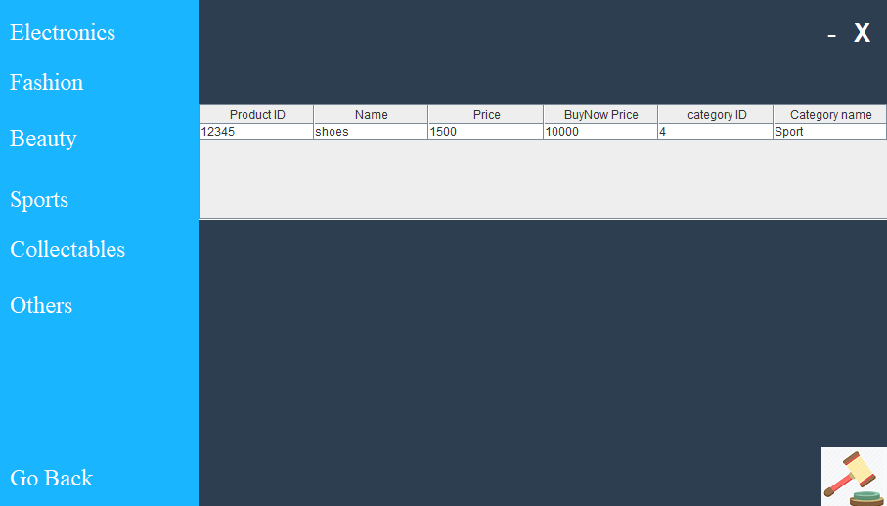
Simulation
Image 15:List of items present in the Auction in Sports Category

Slide 23
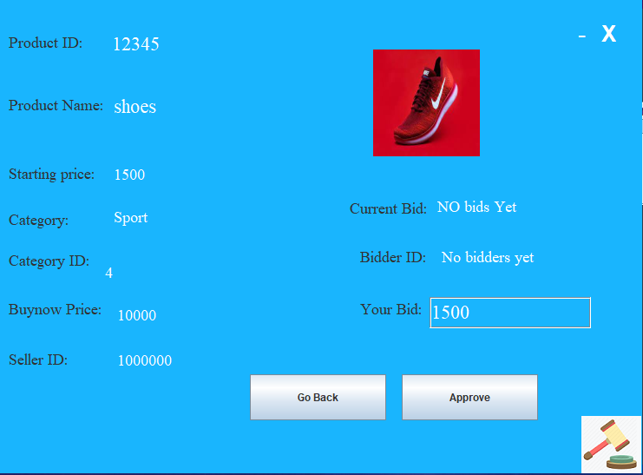
Simulation
Image16:Placing Bid for a particular Product

Slide 24
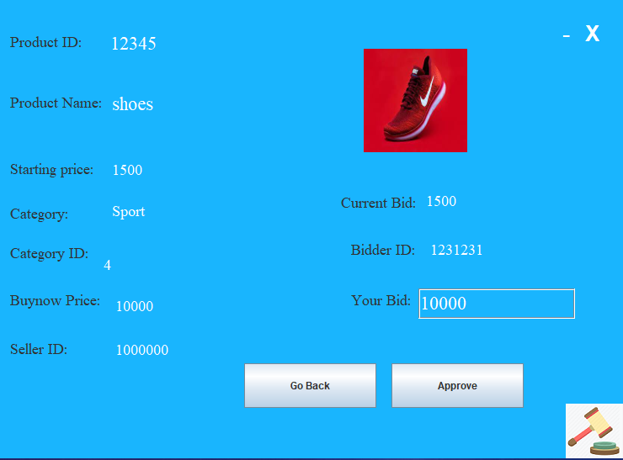
Simulation
Image17:Buying the product out using the bidding amount equal to Buy Now price

Slide 25

Simulation
Image 18:Viewing the sellers sold items list to check whether it has been updated or not

Slide 26
Future Scope
Payment Options
Email Verification
Product/item Verification
Improving the security of the System
User Notifications

Slide 27
Conclusion
Online auctions created have effectively created a giant virtual marketplace where people can gather to buy, sell, trade and check out the goods of the day. This project “Online Auction System” is developed using Java(Netbeans 8.0)as front end and PhpmyAdmin and MySQL Database in back end to computerize the process of auction i.e. selling and buying product.
The huge benefit of using online auction sites to buy your home is that u can place offers at all hours of the day, also it removes geographical boundaries, location etc.

Slide 28
Thank YOu

